Slide 1


Btc enterprise By – The Visionary Minds team Abirami Mohanasundaram Mounika Boju Parth Kalathiya Rechael Vincent Lopes

Slide 2

AGENDA
Agenda
Today we are going to present our prototype of BTC Enterprise's IT department website. The enterprise's IT department has departments that internal and external users can access.

Slide 3
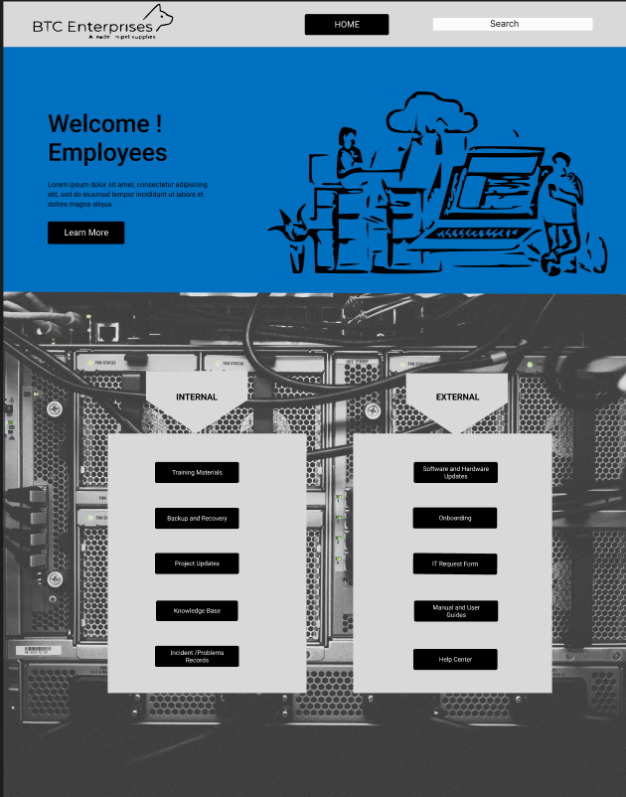
Home page

Slide 4

Onboarding

Slide 5
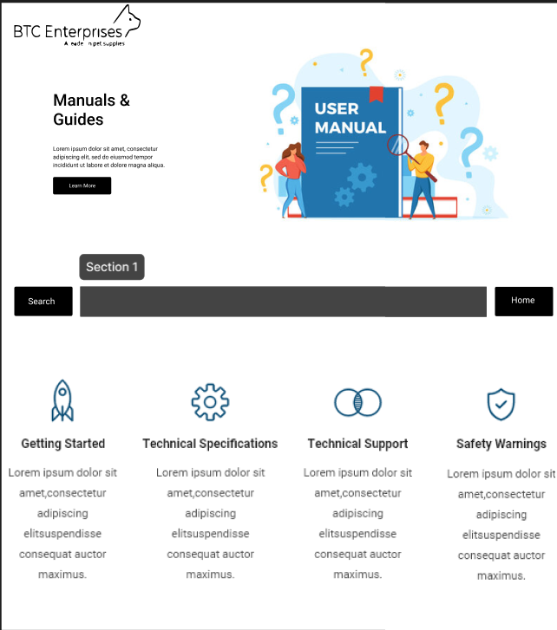
User manuals and guides

Slide 6
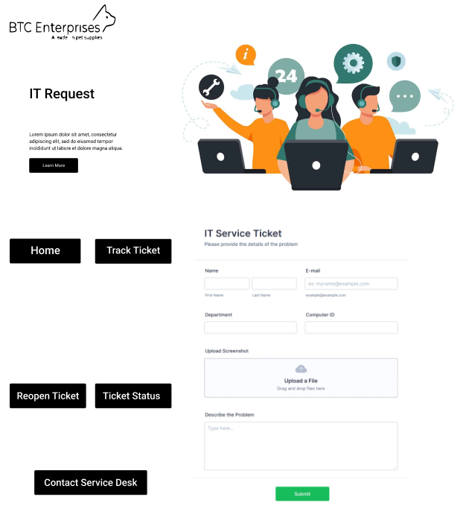
It request form

Slide 7
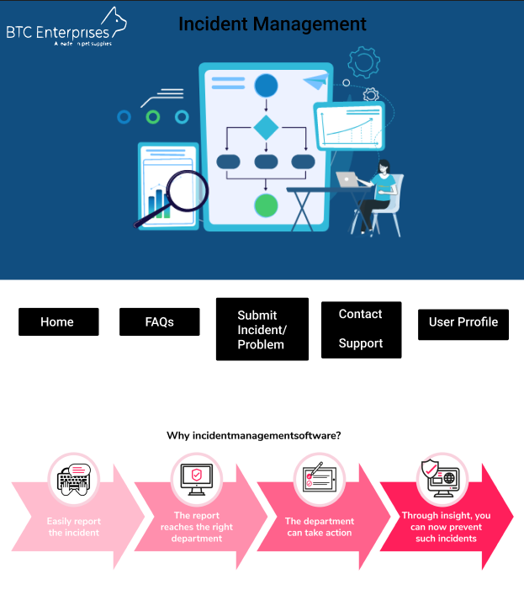
Incident management

Slide 8
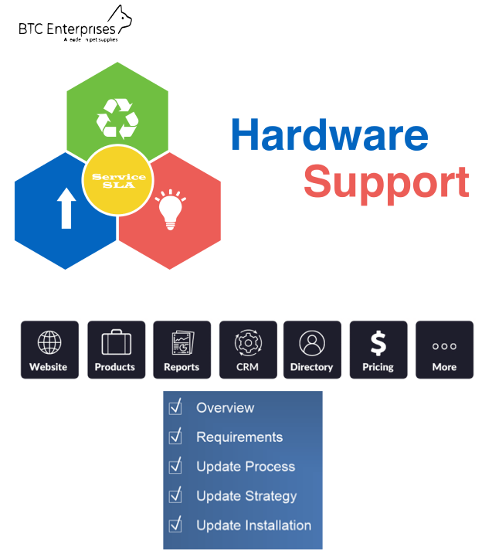
Hardware and software support

Slide 9

Knowledge base

Slide 10

Help Center

Slide 11
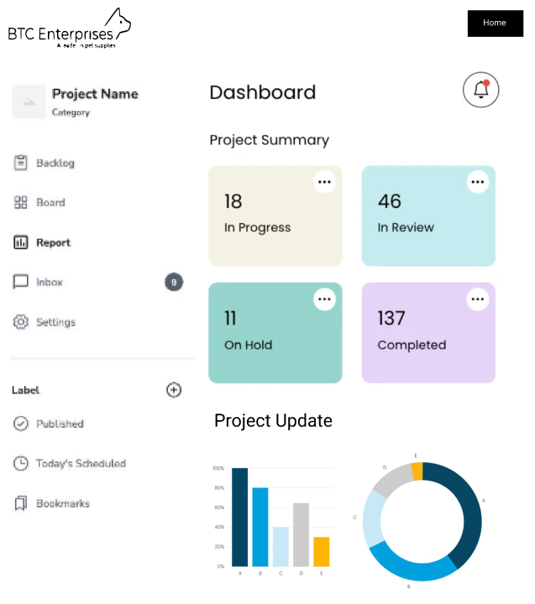
Project updates

Slide 12
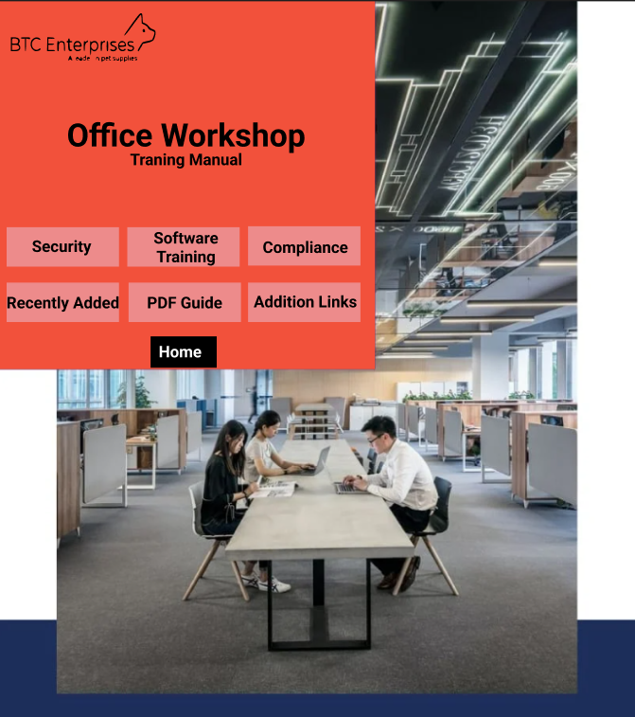
Training manuals

Slide 13
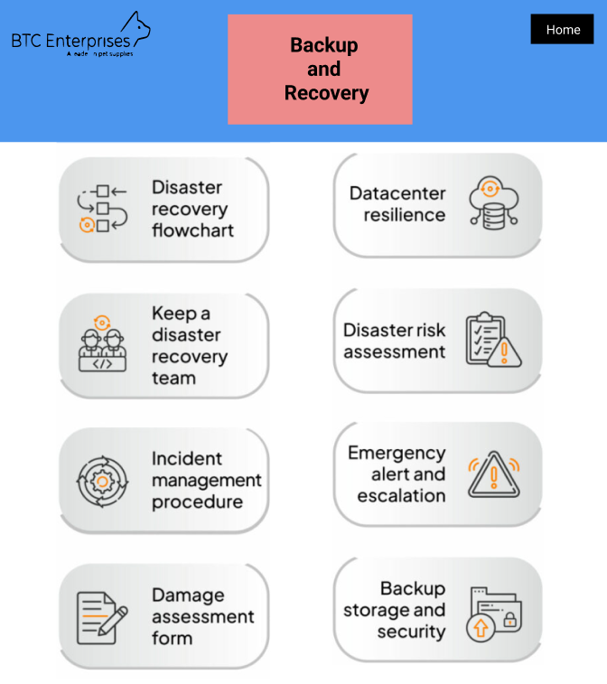
Backup and recovery

Slide 14
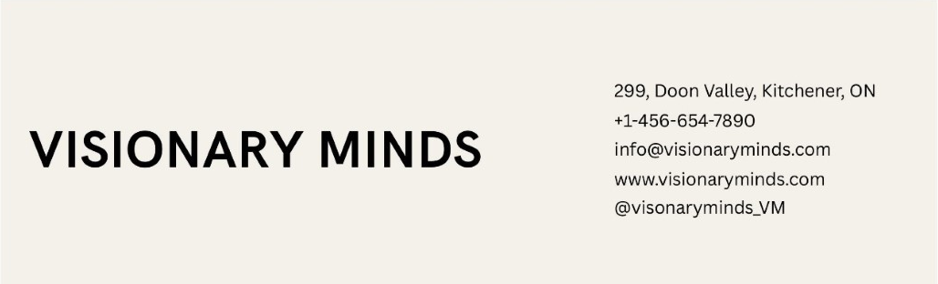
CONTACT US

Slide 15

THANK YOU

